Slide 1
Welcome to Neo Flow
曹家齐

Slide 2

1
Motivation
2
App Introduction
3
Live Demo
4
Summary

Slide 3
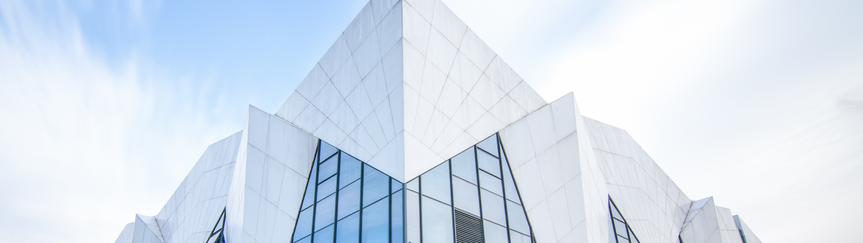
Motivation
01
Why make another Get Things Done App while there already are so many ?

Slide 4
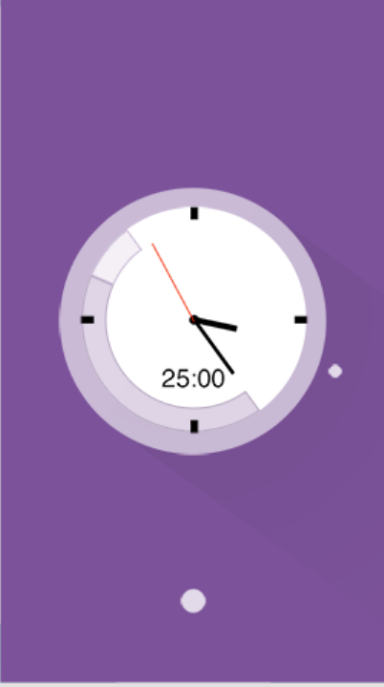
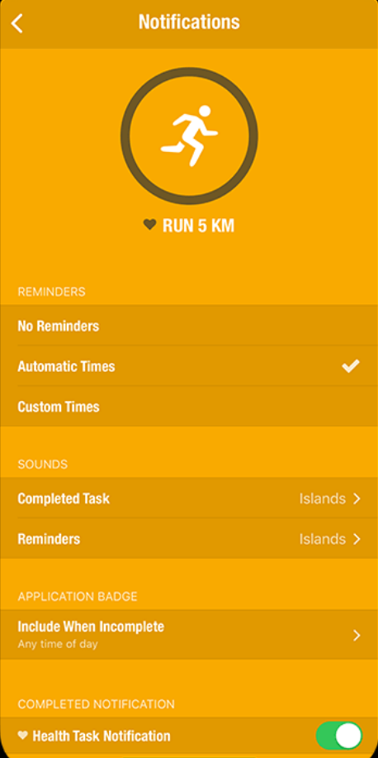
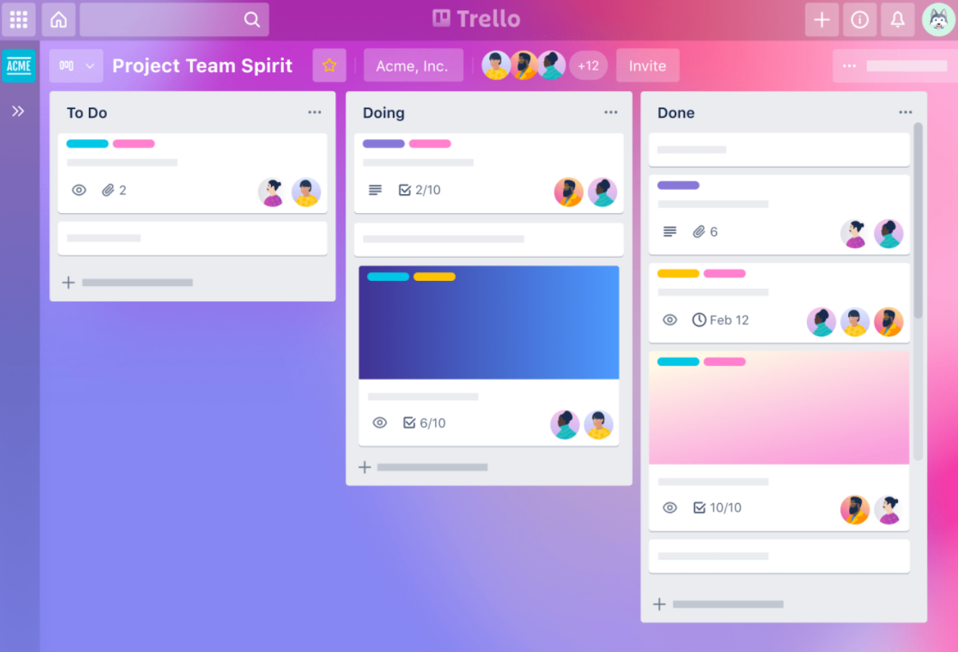
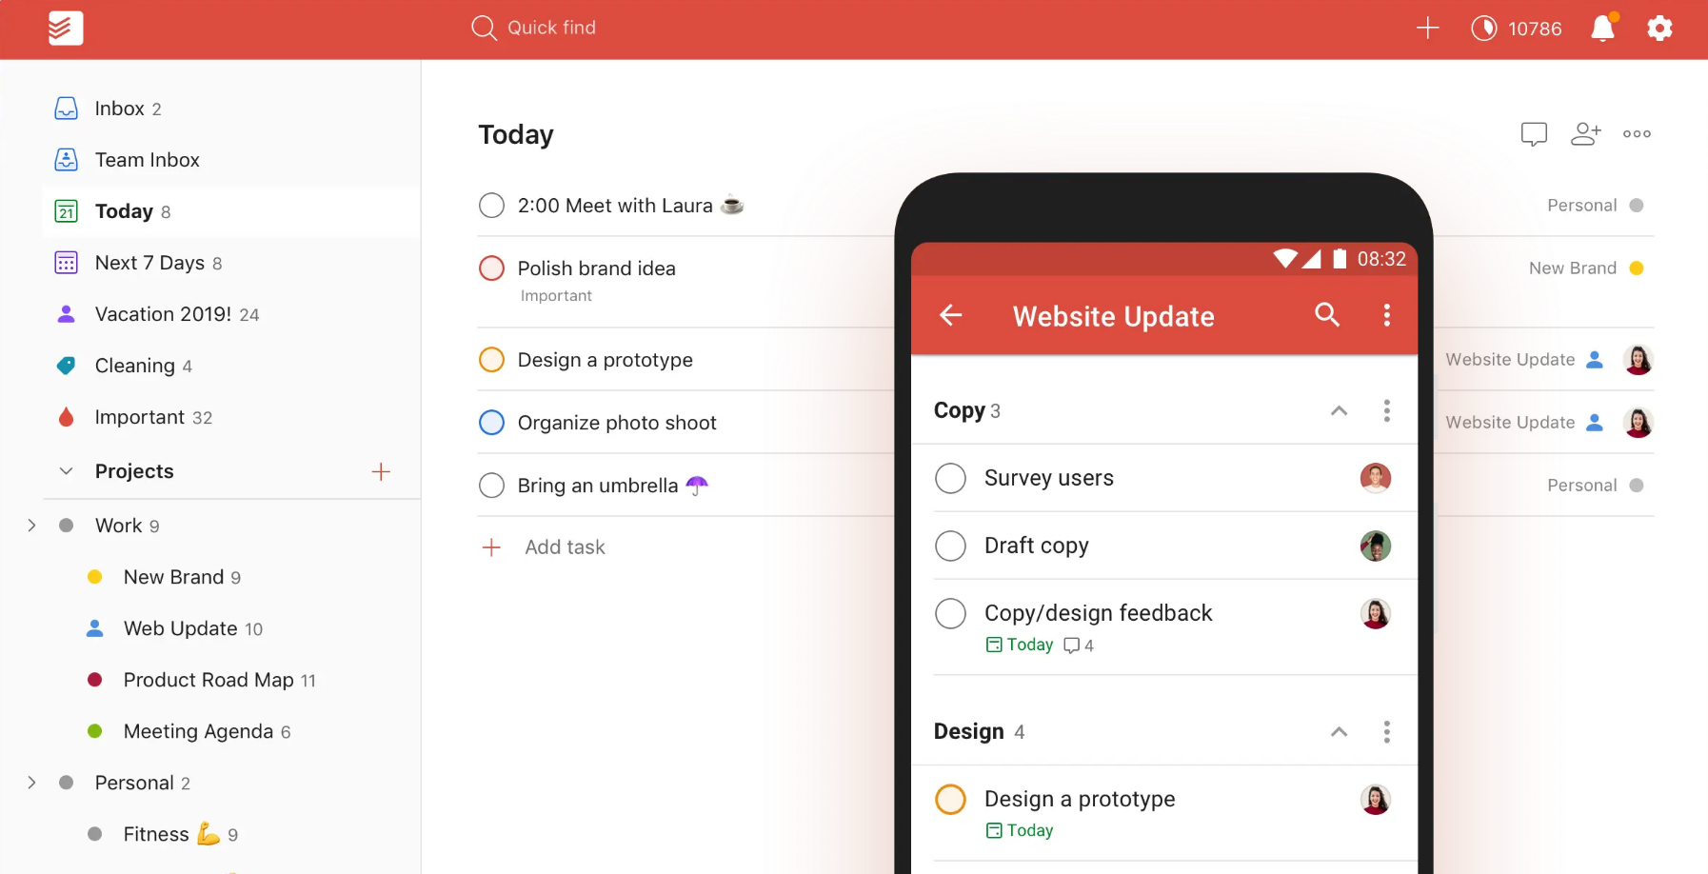
Motivation
Flat Tomato:
A pomodoro APP
Streaks:
A Habit Traking APP
Trello:
A Project Management App
Todoist:
A To-do Memo APP

Slide 5
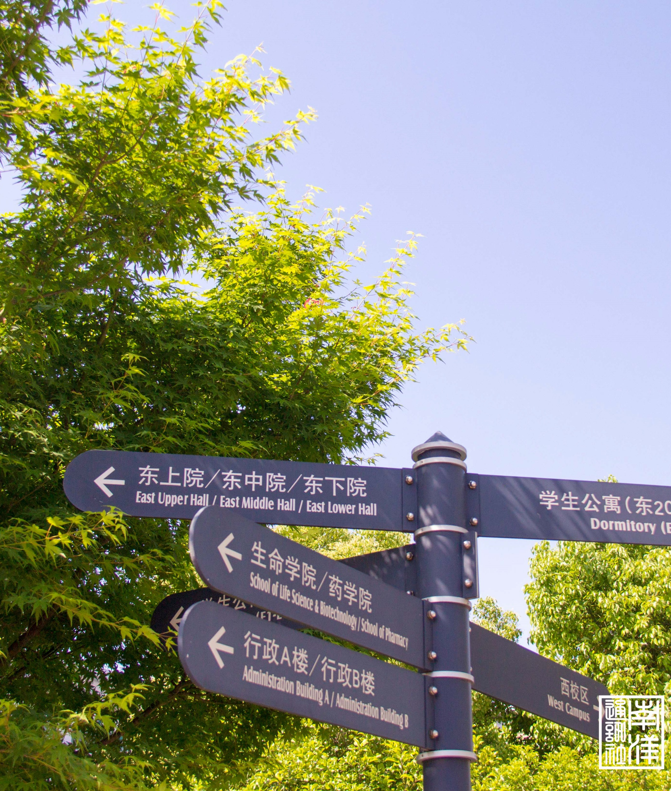
App Introduction
02
All available on my github repo:
https://github.com/Clover-Hill/NeoFlow

Slide 6


03
Live Demo

Slide 7
Summary
04
What’ve I learned from this project

Slide 8
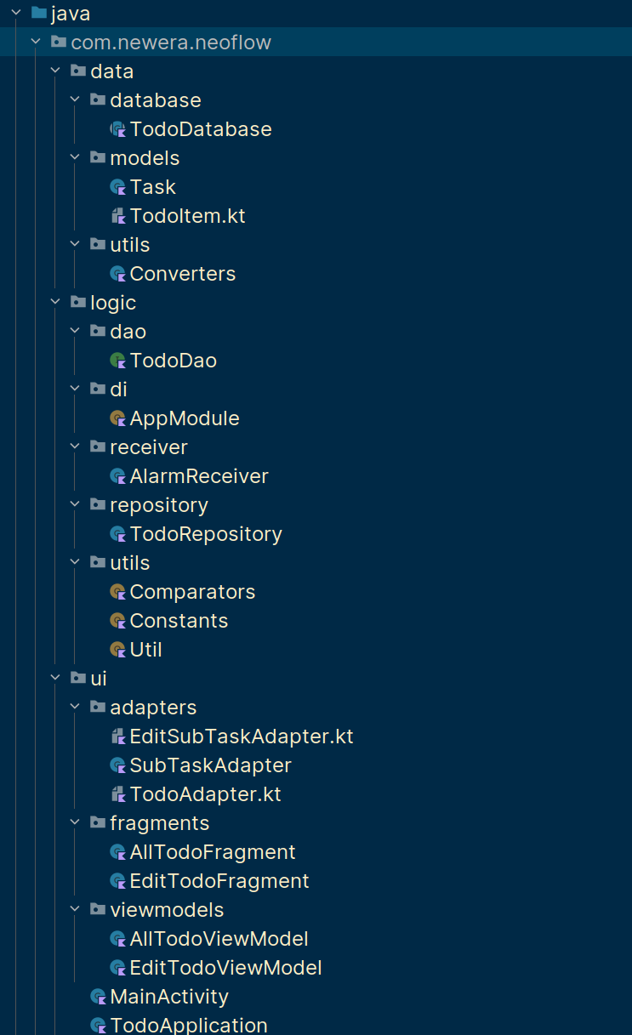
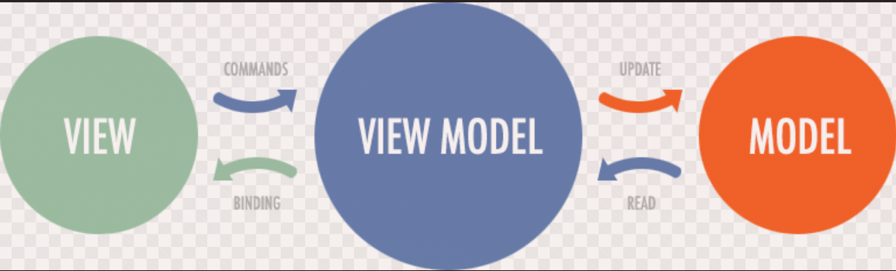
Structure
MVVM Structure

Slide 9
Structure
Data Model
Data Access Object
View Models
Fragments
Layout
Data Base
Data Repos
Adapters

Slide 10
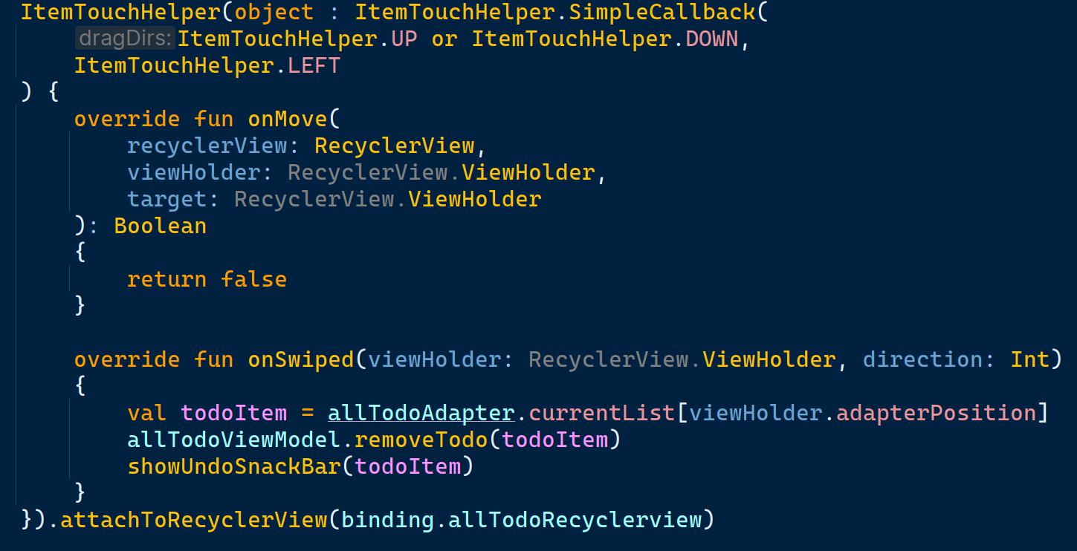
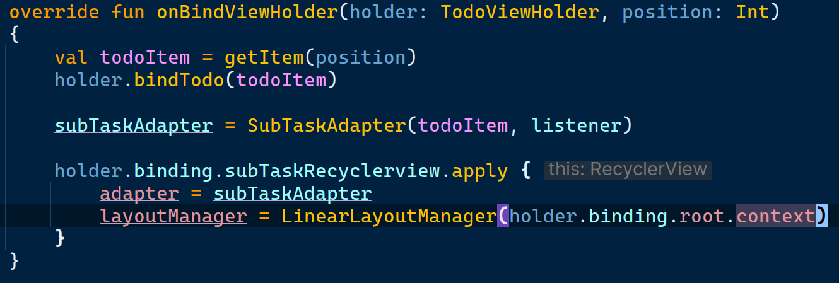
Feature Implementation
1. ListAdapter
2. Nested RecyclerView
Implement Swipe to Delete

Slide 11
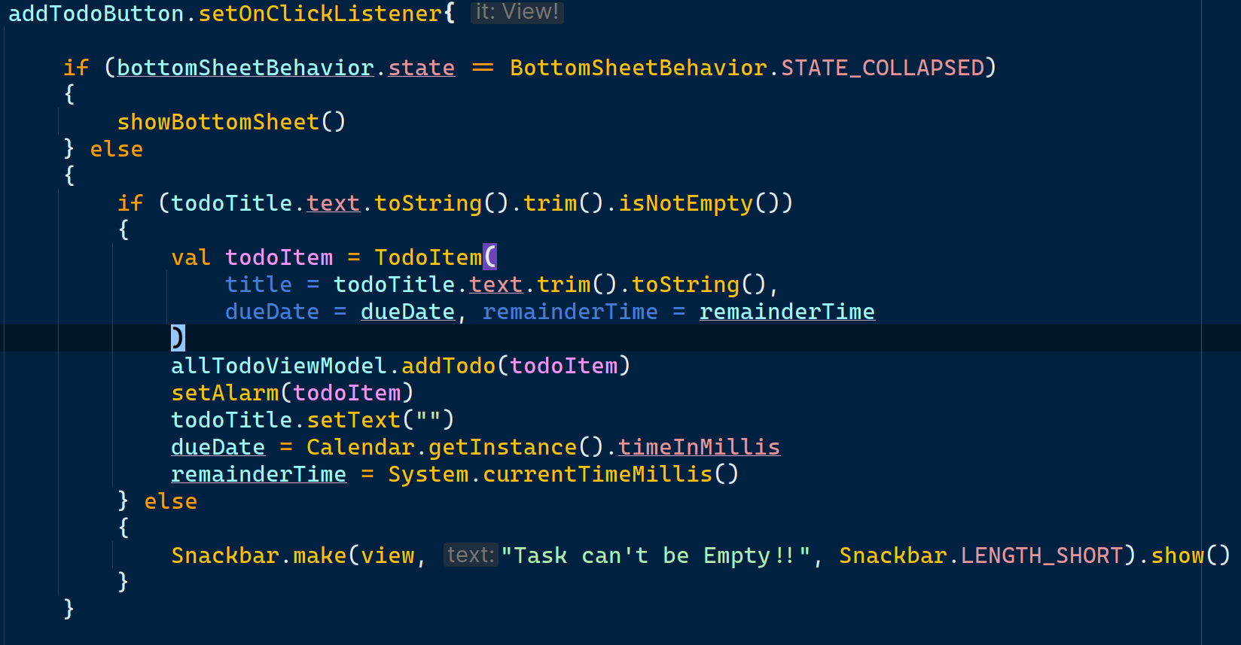
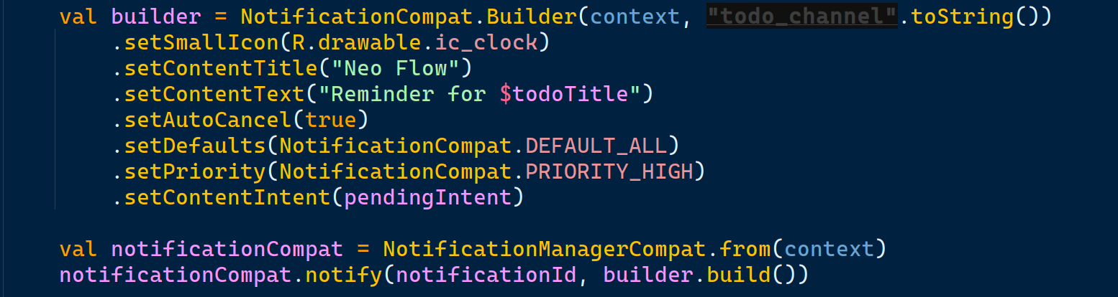
Feature Implementation
Implement Bottom Sheet
Implement Notifications

Slide 12
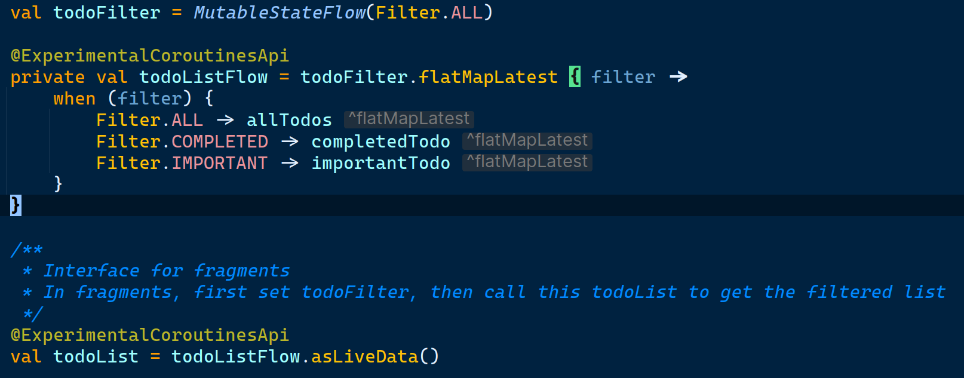
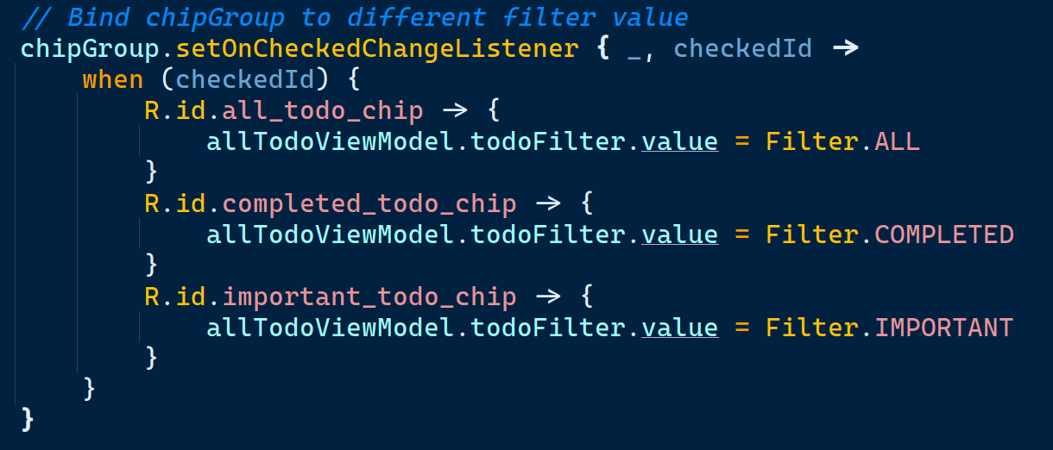
Feature Implementation
Stateflow to filter items
Multiple Material Design Widgets

Slide 13
Thanks

